Slide 1

Sneha Kasetty Sudarshan, Mohamad Shafaat Ali Khan,
Khanh Dao, Tran Pham

Slide 2

SJSU Washington Square
A Comprehensive Study of Mobile Sensing and Cloud Services
Agenda
Introduction - Sneha
Mobile sensor classification - Mohamad
Mobile Sensor Networks - Khanh
Internet of Things Sensing - Tran

Slide 3
Introduction
What is mobile sensing and mobile cloud services ?
Why mobile sensing and cloud services ?
Needs of a mobile sensing system
Challenges and concerns

Slide 4
SJSU Washington Square
What is Mobile Sensing and Mobile Cloud Services
Usage of mobile sensors to accumulate data to build smart application in different domains such as healthcare, transportation, safety, security, environmental monitoring etc is mobile sensing.
External cloud services that are accessible from mobile devices over the internet and process sensor data . eg: Apple’s “iCloud”, Google’s “Google Drive”.

Slide 5
SJSU Washington Square
Why mobile sensing & Cloud services
potential to reach a very large user population .
It is convenient and economical to use the sensors available in the mobile devices .
Using smartphones as a sensing device avoids additional costs to invest in placing standard expensive PC-like devices in people, buses or cars .
Sensors, such as magnetometer, along with Wi-Fi can be used to detect the presence of person’s zone in a building during an emergency evacuation .
Mobile sensors can be used to monitor air pollution which is economical compared to the expensive and hard to install fixed monitoring stations .
Notes:
Mobile sensors have big advantages over static sensors that come from their mobility nature. For instance, when measuring the pollution of city base on the CO2 level, instead of deploying thousands of sensor around the city, equip those sensors on garbage collector truck will provide bigger geo-coverage and the transient from low to high level of CO2 between area or time during the day
Mobile sensing cloud services is a combination of cloud computing and mobile computing and has the advantages of convenience of data access at any time and any place with no terminal hardware limitations
With the rise of many micro mobile devices, mobile sensing systems has the potential to reach a very large user population
It is convenient and economical to use the sensors available in the mobile devices.
Sensors, such as magnetometer, along with Wi-Fi can be used to detect the presence of person’s zone in a building during an emergency evacuation
Using smartphones as a sensing device avoids additional costs to invest in placing standard expensive PC-like devices in people, buses or cars
Mobile sensors can be used to monitor air pollution which is economical compared to the expensive and hard to install fixed monitoring stations

Slide 6
SJSU Washington Square
Needs of mobile sensing system
Mobile sensors capable of collection of the data must be present on the device.
User level application needs to be running on the mobile device.
The device/application should have an Application Programming Interface (API) to manage data and reporting.
Mobile device need to have network connection to access to the cloud service.
The cloud services should comply with web service standards - Simple Object Access Protocol (SOAP) and Representational State Transfer (REST) .
Notes:
Mobile device need to have access to the cloud service. since the mobile device may have constraints such as limited storage capacity and memory, restricted CPU processing capabilities, etc. so that the computation can be offloaded.
The cloud services should comply with web service standards - Simple Object Access Protocol (SOAP) and Representational State Transfer (REST). Mobile applications should be developed to access RESTful and SOAP services

Slide 7
SJSU Washington Square
Challenges and Concerns
Energy efficiency and battery life
Limited storage
Resource adaptability
CPU overhead
Network overhead with limited bandwidth
There are two major concerns in mobile sensing. First is user participation, user has to trigger the sensors to measure the data, which may consume much power. also user needs to upload the data which will consume 3G data quota or user might need to move to a particular location to sense the data
Second is privacy, private information can be obtained from the users’ contributed data. Such privacy concerns and extra efforts required by the user to gather the data may hinder the user’s participation
Notes:
There are a number of design challenges in the software architecture of mobile devices such as energy efficiency, resource adaptability [1.9]. Energy efficiency is the energy required to deliver a mobile service at a given quality of service (QoS). Energy efficiency becomes a top concern since the mobile device is impacted by the use of high energy consumption sensors, heavy computation load, screens etc [1.9]. Resource adaptability is the ability to adapt flexibly to environment changes. For examples, fluctuating availability of sensing, network availability and accessibility, wireless communication options etc.

Slide 8
SJSU Washington Square
Sensors and Mobile sensors
Sensors: Sensors are devices that can detect and respond to some kind of input from the surrounding and produces a result output on a display
Mobile Sensors: Sensors which posses the quality of mobility.
Comparison between sensors and mobile sensors.
 | Sensor | Mobile Sensor
Motion | Stationery | Mobile
Area Constraints | Yes | No
Power Management | More | Less
Cost | High | Low
Maintenance | High | Low
Notes:
Evolution of mobile sensors:
1980’s: interest of phenomena, 1990’s: monitor animals, 2000’s: mobile phones like gps and accelerometer, today: smart phone, wearable objects, IOT and what not

Slide 9
SJSU Washington Square
Mobile Sensors Classification
Classification of Mobile sensors is based on two bases
Physical properties
Applications/Uses
Mobile sensors
Physical Properties
Application/Uses

Slide 10
SJSU Washington Square
Physical Properties
General Classification
Acceleration, Thermal, Image, Light etc
Embedded or External
Embedded sensors which are inside the device. Eg: Tactile sensors
External sensors which are outside the device.
Proprioceptive or Exteroceptive
Proprioceptive measure properties internal to a device. Eg: Acceleration sensors
Exteroceptive measures properties external to a device. Eg: Light sensors
Active or Passive
Active sensor measures energy generated into the surroundings. Eg: Radio sensors
Passive sensors measures energy generated from the surroundings. Eg: Water Sensors

Slide 11
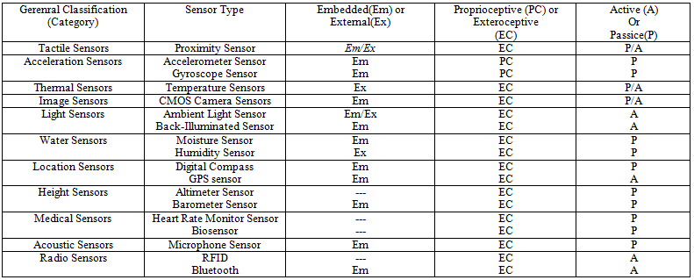
SJSU Washington Square
Classification: Physical Properties

Slide 12
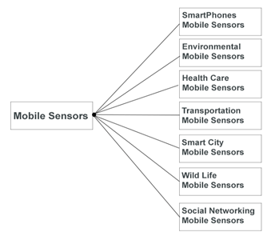
SJSU Washington Square
Applications/Uses

Slide 13
SJSU Washington Square
Smart Phones
Location sensor
Accelerometer Sensor
Compass Sensor
Gyroscope sensor
Image Sensor
Light Sensor
Touch Sensors
Proximity Sensor
Humidity Sensor
Temperature Sensors

Slide 14
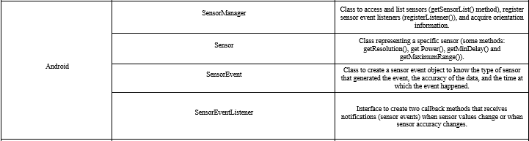
SJSU Washington Square
Smart Phones

Slide 15
SJSU Washington Square
Environmental Sensors
Monitoring of environment.
Air quality. Eg Opensense
Noise Pollution maps.
Pluggable O3 sensors
Earthquakes and shake intensity maps

Slide 16
SJSU Washington Square
Healthcare Sensors
Wearable sensors like fitbit etc
Remote patient monitoring devices.
Mobile sensors which display electrical signals which heart produces.
Mobile sensors which amplify the sound organs like veins, arteries and hearts.
Inhaler with inbuilt asthma sensor.
Notes:
This device tracks how often a person is taking medicine and it provides health keepers informed about the disease management.

Slide 17
SJSU Washington Square
IoT, Smart City & Transportation
Structural Health of Buildings
Waste Management
Air Quality
Noise Monitoring
Traffic Congestion
Smart Parking

Slide 18
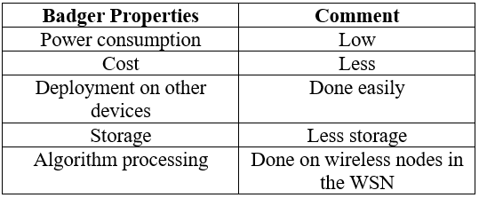
SJSU Washington Square
Wild Life
Monitor behavior of wild animals
Usage of Badger
Notes:
badger are small devices which can be fixed on a wearble object. This wearable object is then place on the animals body. they either wrap it towards the neck of the animal or simple tie it to the leg.

Slide 19
SJSU Washington Square
Social Networking
Face to face interactions
File sharing using bluetooth
ad-hoc services
Selfies

Slide 20
SJSU Washington Square
Mobile Sensor Network
Collection of small, portable and lightweight embedded mobile sensor devices with network capabilities.
Monitor features such as temperature, pressure humidity, illumination intensity, vibration intensity, sound intensity, chemical concentration, vital body function
Notes:
So, what is mobile sensor network?

Slide 21
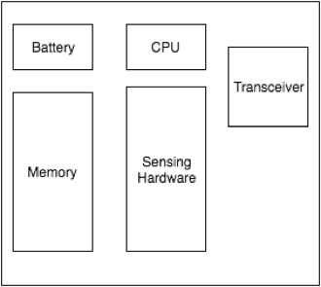
SJSU Washington Square
Sensor Node Component
Transducer: generate electrical signal based on sensed physic effects
Transceiver: receive commands from central computer and transmit data
Micro-controller powered by battery
Sensor Node components

Slide 22
SJSU Washington Square
Advantages of WSN
More versatile than normal static and individual sensor network
Ability to cover wide range of sensing and cope with rapid topology change
Collaborate and combine data to increase the accuracy of change data
Provide extended functionality such as forwarding service
Flexible to be deployed in any scenarios.

Slide 23
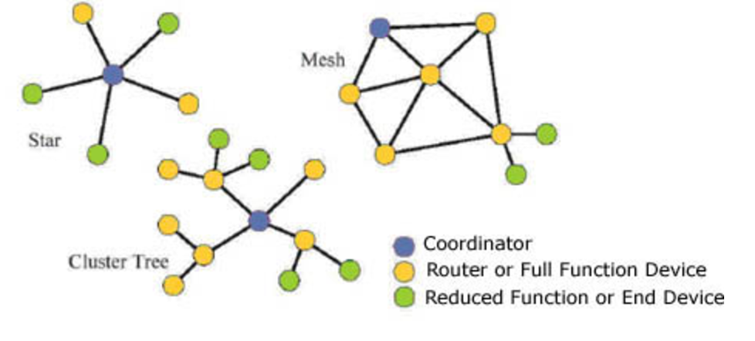
SJSU Washington Square
Network structures
Notes:
Star Network
Require the base station be within radio transmission range, allow low latency communications between remote node and base station
Simple and keep remote node’s power consumption to a minimum
Mesh Network
Node can communicate with other node that is out of the radio communication ranges through intermediate forward node.
Provide redundancy and scalability that the system needs in order to prevent failure of a single node crashes the systems
Hybrid Star - Mesh Network
Robust and versatile to keep minimum power consumption.
Sensor nodes with lowest power are not enabled with the ability to forward messages.
Only nodes with multi-hop capability are higher power, and often plugged into electrical main lines.

Slide 24
SJSU Washington Square
Types of WSN
One layer (Flat or planar network)
Device communicate in ad-hoc manner, all communicate over the same network
Multi-hop network communication => packet may be lost
Two-layer network
Consist of stationary nodes and mobile nodes connect with each other
When node become disjoint, mobile entities position themselves to re-establish connectivity
Three layer network
Consist of a set of stationary sensor nodes passing data to set of access points
Cover wide network area
Compatible with several application simultaneously
Notes:
At node level, mobile sensor are categorized based on role in sensor network
mobile embedded sensor: in this architecture, the external forces direct the motion of sensor network
mobile actuated sensor: sensor node have locomotion capability, which enables them to move throughout the sensing region
data mule: mobile device needs to collect data to deliver to base station
access point: mobile nodes can position themselves to maintain network connectivity in spare networks

Slide 25
SJSU Washington Square
Routing Protocol Taxonomy

Slide 26
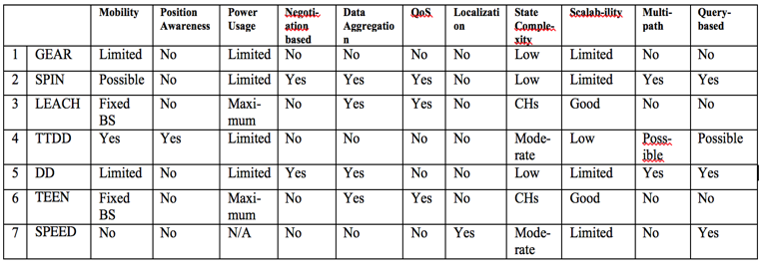
SJSU Washington Square

Slide 27
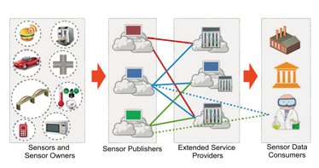
SJSU Washington Square
Sensing as a Service
Sensor and sensor owner layer: Protect the security and privacy, prevent unwanted data published to SP layer.
SPs layer: By obtaining permission to publish to cloud, SPs layer collects information about the sensor availability, owner preferences, expected return and restriction. Eg: Xively, OpenIoT.
ESPs layer: Intelligent layer, services could be widely ranged from one provider to another.
Sensor data consumer layer: Consists of sensor data consumers. All sensor needs to registered with a valid certificate in order to consume data. Sensor data consumers don’t directly communicate with sensors or sensors owner: all the transactions are performed through either SPs or ESPs.
Sensing as a service model

Slide 28
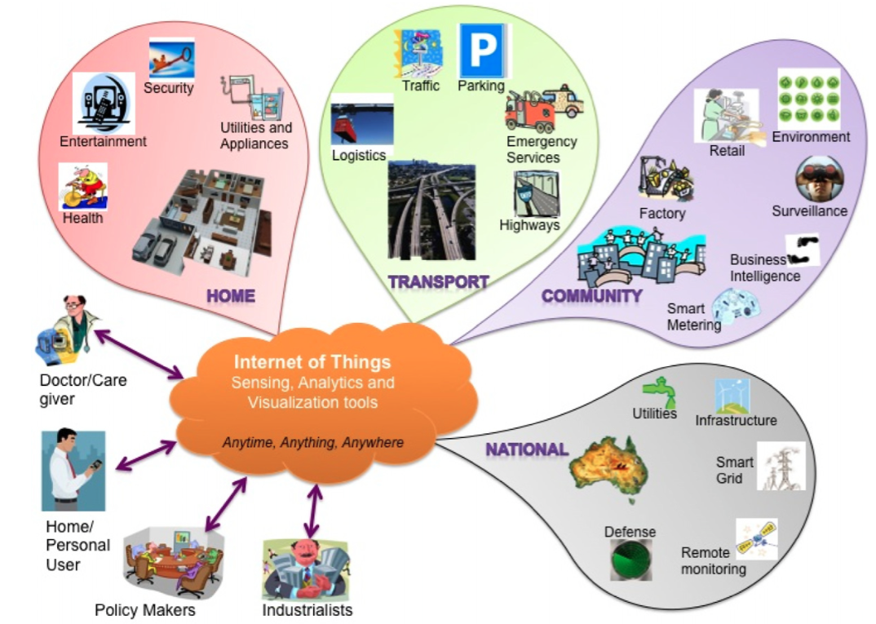
SJSU Washington Square
Internet of Things Sensing
Notes:
The term “Internet of Things” was first used by Kevin Ashton in 1999, when he presented about supply chain management. Up till now the term is extended with the broaden of “things” that went out the border of supply chain management. One of the most popular definitions which is currently in use is: “The “Internet of Things” is the general idea of things, especially everyday objects, that are readable, recognizable, locatable, addressable, and controllable via the Internet - whether via RFID, wireless LAN, wide-area network, or other means.” - U.S. National Intelligence Council

Slide 29
SJSU Washington Square
“The “Internet of Things” is the general idea of things, especially everyday objects, that are readable, recognizable, locatable, addressable, and controllable via the Internet - whether via RFID, wireless LAN, wide-area network, or other means.” - U.S. National Intelligence Council

Slide 30
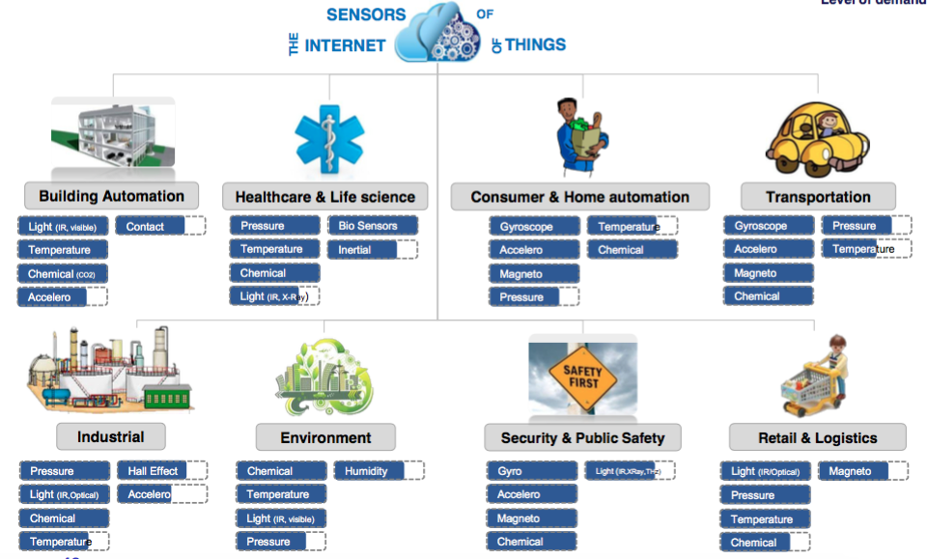

Slide 31
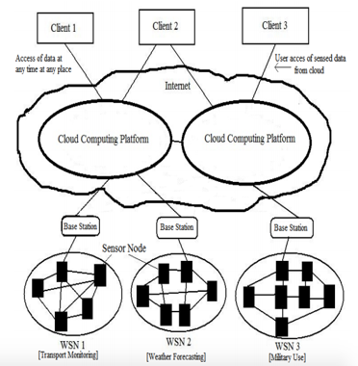
SJSU Washington Square
WSN & Cloud Computing
Notes:
Combination of WSN and cloud computing bring the power of cloud technology to solve the existing problem with mobile sensing: distributed data integration, big data analysis, storage…especially the limited computing power of mobile sensor hardware. The overview infrastructure of Mobile sensor cloud can

Slide 32
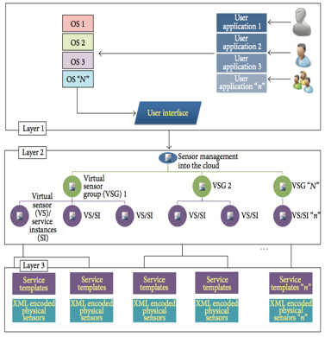
SJSU Washington Square
Infrastructure
Virtualization
Standardization
Automation
Monitoring
Grouping
Service Model
Notes:
Virtualization: things or mobile sensor are highly heterogeneity and scattered. An abstraction layer is necessary to hide the locations and the specifications of physical sensors. Fig.4.3 describes the relationship among virtual sensor groups, virtual sensors, and physical sensors. Each virtual sensor is created from one or more physical sensors. A virtual sensor group is created from one or more virtual sensors. Base on their need, users will create virtual sensor groups and include all the sensors they need. They can activate or inactivate their virtual sensors, check their status, and set the frequency of data collection from them…
Standardization: different kinds of “things” and physical sensors have different mechanism to control and collect data.. By virtualizing the physical sensor and define standard functions for virtual sensors, we enable users to access sensors with the standardized functions without concern for the differences among the physical sensors. Mobile Sensor-Cloud infrastructure translates the standard functions for the virtual sensors into specific functions for the different kinds of physical sensors.
Automation: Mobile Sensor-Cloud infrastructure is an on demand service delivery and supports the full lifecycle of service delivery from the registration of physical sensors through creating templates, requesting of virtual sensors, provisioning, starting and finishing to use virtual sensors, and deleting the physical sensors. These forms of support are automatic and delivered without human operations. This will help improve the service delivery time and reduce the cost.
Monitoring: mobile sensors have more connectivity problem than static sensors. There’re higher chance they’re off the grid due to numerous reasons. Applications owner will need tool to monitor availability of sensors to sustain the quality of their services.
Grouping: Mobile Sensor-Cloud infrastructure can provide virtual sensors as virtual sensor groups. Users can control each virtual sensor and virtual sensor groups, set the access control and the frequency of data collection for virtual sensor groups.
Service Model: Mobile Sensor Cloud Infrastructure support multi-tenant, sharing various sensors as a service. Mobile Sensor-Cloud infrastructure is responsible for maintaining the quality of the service. We define the roles assigned to the participants joining the service, considering their merits and creating an appropriate cost model to support the service.

Slide 33
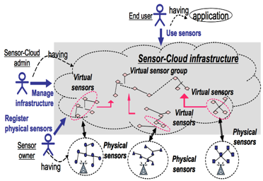
SJSU Washington Square
Services
Notes:
Sensor Owner: A sensor owner is an actor who owns physical sensors.
Registers the physical sensors with their properties to Mobile Sensor-Cloud infrastructure
Deletes the registration of sensor when s/he quits sharing them.
Get rental fee for using the physical sensors. The fee reflects the actual usage of the physical sensors.
Mobile Sensor-Cloud Administrator: manage all the services provided by Mobile Sensor Cloud Infrastructure.
Manages the IT resources for the virtual sensors, monitoring, and the user interfaces.
Prepares the templates for the virtual sensors and for some typical virtual sensor groups.
Charge the end users for the delivery of the Sensor-Cloud infrastructure service.
Paid the sensor owner base on the usage on their sensor
End User: the actor with one or more applications or services that use the sensor data with no detailed knowledge about the physical sensors.
Requests the use of virtual sensors or virtual sensor groups that satisfy the requirements from the templates.
Use/modify existing template of virtual sensor group created by Mobile Sensor Cloud Administrator or creates a new template. End user can share their template.
Control her/his virtual sensors directly or via a Web browser.
Monitor the status of the virtual sensors. When they become unnecessary, end user can release them.
Paying for usage of sensor data/actuator

Slide 34
SJSU Washington Square
Services (cont)
Services | Functionalities
SaaS (Sensing as a Service) | Providing ubiquitous access to sensor data;
SAaaS (Sensing and Actuation as a Service) | Enabling automatic control logics implemented in the Cloud;
SEaaS (Sensor Event as a Service), | Dispatching messaging services triggered by sensor events;
SenaaS (Sensor as a Service) | Enabling ubiquitous management of remote sensors;
DBaaS (DataBase as a Service), | Enabling ubiquitous database management;
EaaS (Ethernet as a Service) | Providing ubiquitous layer-2 connectivity to remote devices;
IPMaaS (Identity and Policy Management as a Service), | Enabling ubiquitous access to policy and identity management functionalities
VSaaS (Video Surveillance as a Service), | Providing ubiquitous access to recorded video and implementing complex analyses in the Cloud.

Slide 35
SJSU Washington Square
Issues and challenges
Design issues
Power (Battery)/energy efficiency Issues
Event Processing and Management
Service Level Agreement (SLA) Violation
Security and Privacy Support Issues
Real-Time Multimedia Content Processing and Massive Scaling
Bandwidth Limitation
The need for standard
Pricing Issues
Maintenance Issues
Notes:
Design Issues. The complexity to build an application on Mobile Sensor Cloud is huge, besides there’s great amount of issues to be handled. One particular issues with mobile sensor is a reliable and continuous transfer of data from mobile sensor devices to the server. For example, the connectivity from the mobile sensor to the gateway can be lost when the sensor moves out of coverage area. [4.8] [4.9]
Power (Battery)/energy efficiency Issues. Wireless connection uses more energy than a wired connection. This issues become more severe when mobile sensor usually has low power battery and the continuous data transmission to the would drain the battery very quickly. Thus, energy saving is a major issue and energy efficient management is more than desirable [4.8]
Event Processing and Management.There’re many complex event processing and management issues to be solved [4.8]:
(a) The events may come from different sources in different time. With delay in network, how the events should be synchronized?
(b) Change management. When event-processing rules change, how to apply it without affecting the system?
(c) Different sensors come with different type of messages and events. How the messages and events of varying types are supported?
(d) The number of events and its conditions is enormous, how to support in an optimal way?
Service Level Agreement (SLA) Violation. End-users demand a specific level of Quality of Service. So, we need a reliable dynamic collaboration among cloud providers. Agreement between cloud providers to provide a single standard of QoS to end-user is still a big challenge in terms of cost, time, and discrepancy. [4.8]
Security and Privacy Support Issues. As not just sensors but “things” are connected to the internet. It’s very dangerous if a hacker can hijack into the system, take control and get very private and sensitive info from wearable devices of sensor’s owner. Worse, hacker can take control and send command to the actuator to initiate action in physical world and cause harm to the sensor owner.
Real-Time Multimedia Content Processing and Massive Scaling. Current technologies have their limitation and cannot completely solve all issues related to the complexity of big data. Data from IoT sensing is huge and require great processing power. The gap between data available and data can process is getting wider. New technologies and data processing techniques are required to analyze large volumes of data faster with efficient resource and power consumption [4.8]
Bandwidth Limitation. Bandwidth limitation is one of the current big challenges that have to be handled in Sensor-Cloud system. The number of sensor devices and their cloud users increases dramatically [4.12]. The number of IoT devices will reach 50 billion by 2025 (Cisco estimation). It’s a very difficult task to manage the bandwidth allocation for a gigantic infrastructure consisting of huge number of device assets and cloud users. [4.8]
The need for standard. IoT is highly heterogeneity so a standard protocol, architecture and APIs are very necessary to facilitate the interconnection between IoT and services that interact with IoT [4.13]. [4.8]
Pricing Issues. The services of Mobile Sensor-Cloud involve both the sensor-service provider (SSP) and cloud- service provider (CSP). Therefore, both SSPs and CSPs have to solve the differences in their customer’s management, services management, and modes and methods of payments and pricing. [4.8]
Maintenance Issues. In order to keep the end users’ loyalty, the cloud should cope with the service failure. For this a regular maintenance is needed and redundancy techniques should be implemented to ensure the smooth and continuous flow of services

Slide 36


